Slide 1

StickyMinds.com and Better Software magazine presents…
How to Drive Quality
with a Strategic QA Approach
Sponsored by Telelogic
Non-streaming participants should call 1-866-421-6339
International non-streaming participants should call 1-904-596-2360

Slide 2



How to Drive Quality
With A Strategic QA Approach
Dominic Tavassoli
Vice President, Change Management Solutions

Slide 3
The Quality Assurance Paradox
Software quality must very high!
Bugs are much more visible than before.
Complexity is increasing
  Variant of Moore’s law: the amount of software in a system is doubled every 18 months
Time to market is critical
Cost control
Does quality assurance conflict with cost control and time to market?
Can QA actually decrease cost and improve time-to-market???
Notes:
Customers expect software quality to be very high, and yet we frequently hear in the news about bugs or design errors that cost time, money or worse, lives.
As software development becomes more complex, innovative, and created by distributed teams, delivering quality is increasingly difficult.
Quality assurance (QA) generally focuses on testing the software in the final stages of a project, when budgets are scarce and the pressure to deliver the product is high.
To ensure quality, project managers must balance quality assurance with time to market.

Slide 4
How Much Testing Is Enough?
There is always one more bug…
So how much testing is needed to find “all” the bugs?
  Cost
  Time to market
  Feasibility
  Industry-specific standards
Can you predict how many bugs there will be in a release?
In order to provide correct budget and schedule estimates, QA managers need the means to predict fault levels.
Notes:
“There is always one more bug.”
The amount of testing needed to ensure quality is hard to quantify. Very few project teams are able – or are willing – to predict how many bugs there will be in a release. Testing and fixing until all bugs have been found would be a very expensive task, if it were possible. And is it reasonable? Most organizations prefer to deliver a product on time, with a few unimportant defects, rather than to deliver it six months late. Needless to say, each industry has a different level of acceptable quality, for instance, word processors versus aircraft systems.
In order to provide correct budget and schedule estimates, QA managers need the means to predict fault levels.

Slide 5
Quality Control or Quality Driven?
Verification and validation: testing the final software
Outsourcing functional testing to low-cost countries
  Does this make ensuring quality “somebody else’s problem?”
Quality control
  Checking after the fact that quality levels are met.
  Does it help teams build better software?
  Frustrating role for the QA manager, confined to the role of inspector of other people's work.
How can we inject quality from the start of the project?
Notes:
Many organizations often limit QA to testing the final software. Functional testing may be outsourced to low-cost countries, which makes ensuring quality “somebody else’s problem.” In fact, this activity is quality control – checking after the fact that quality levels are met. On its own, quality control doesn’t help teams build better software, a fact that can be very frustrating for the QA manager, as he is confined to the role of inspector of other people's work.

Slide 6
Introducing Strategic QA
Strategic QA helps organizations
Track faults across the software development lifecycle,
  Providing teams with the insight necessary
  to predict fault levels,
  to focus process improvement and testing budgets
  and demonstrate results and ROI.
Strategic QA not only helps organizations become more competitive, it also reaffirms the value of the QA manager in the project team and the organization.
Notes:
… helps organizations track faults across the software development lifecycle, providing QA managers with the insight necessary to predict fault levels, testing budgets and, more importantly, allows them to focus process improvement budgets in an efficient way, with provable benefits. Strategic QA not only helps organizations become more competitive, it also reaffirms the value of the QA manager in the project team and the organization.

Slide 7
SDLC Phases
Defects and errors can be introduced and found during the different phases of the Software Development Lifecycle (SDLC). In this presentation, we will use the following phase names, although all processes apply:
  Requirements analysis,
  Design,
  Implementation / Coding,
  Unit Testing,
  Integration testing,
  System testing, and
  Customer usage (maintenance).
Notes:
… helps organizations track faults across the software development lifecycle, providing QA managers with the insight necessary to predict fault levels, testing budgets and, more importantly, allows them to focus process improvement budgets in an efficient way, with provable benefits. Strategic QA not only helps organizations become more competitive, it also reaffirms the value of the QA manager in the project team and the organization.

Slide 8

Entomology 101: Errors and defects
The industry uses multiple terms and different standards to name software problems… we’ll use the following:
  “Errors” are problems detected in the phase they were created in
  “Defects” are problems detected after the phase they were created in
  “Fault” is the generic term for a defect or an error
Notes:
The industry uses multiple terms and different standards to name software problems… we’ll use the following:
“Errors” are problems detected in the phase they were created in
“Defects” are problems detected after the phase they were created in
“Fault” is the generic term for a defect or an error

Slide 9
Slipping Through The Cracks
Two metrics are of particular interest to track and understand quality in the SDLC:
  Phase Containment Effectiveness (PCE) is the ratio of faults captured in a phase (represents how effective the process is at preventing problems from becoming defects)
  Phase Screening Effectiveness (PSE) is the ratio of prior escaped defects captured in each phase
Notes:
Two metrics are of particular interest to track and understand quality in the SDLC:
Phase Containment Effectiveness (PCE) is the ratio of faults captured in a phase (represents how effective the process is at preventing problems from becoming defects)
Phase Screening Effectiveness (PSE) is the ratio of prior escaped defects captured in each phase

Slide 10
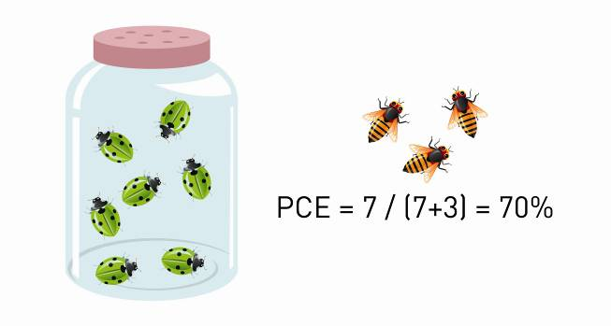
Phase Containment Effectiveness
PCE is the ratio of faults captured in a phase
  For instance, if during the design phase of a project, ten faults were introduced, seven of which were caught but three were in the design specification given to the developers to code from, then this phase had 7 Errors, 3 Defects, and its PCE is 70%
Notes:
PCE is the ratio of faults captured in a phase
For instance, if during the design phase of a project, ten faults were introduced, seven of which were caught but three were in the design specification given to the developers to code from, then this phase had 7 Defects and 3 Errors.

Slide 11
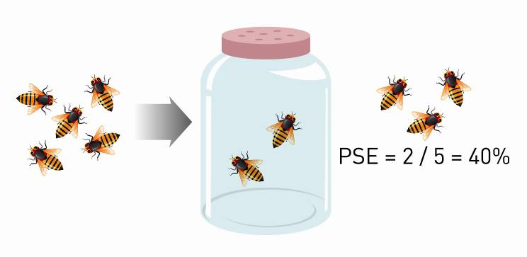
Phase Screening Effectiveness
PSE is the ratio of prior escaped defects captured in each phase
  If, out of the 5 defects present after unit testing, 2 were caught by Integration Testing and 3 were still present in the version delivered for System Testing, the PSE for the Integration Testing phase would be 40%.
Notes:
PSE is the ratio of prior escaped defects captured in each phase
If, out of the 5 faults present after unit testing, 2 were caught by Integration Testing and 3 were still present in the version delivered for System Testing, the PSE for the Integration Testing phase would be 40%.

Slide 12
The Benefits Of Tracking Fault Metrics
Phase effectiveness metrics quantify the organizations capability to find and fix defects closer to their origin, before the cost of rework becomes too important.
  Remember, the longer a defect is in the process, the costlier it is to fix.
By implementing strategies to improve these metrics, organizations can:
  Reduce the number of released defects
  Reduce cost of development
  Avoid project delays
Improve customer satisfaction and lower the cost of maintenance.
Notes:
Phase effectiveness metrics quantify the organizations capability to find and fix defects closer to their origin, before the cost of rework becomes too important.
By implementing strategies to improve these metrics, organizations reduce the number of released defects and avoid project delays, improving customer satisfaction and cost of maintenance.

Slide 13
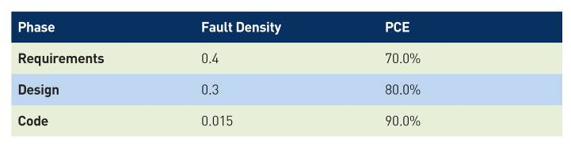
Predicting Faults Throughout The SDLC
By capturing fault data on projects, organizations can estimate Fault Density (FD)
  The number of faults present in a work product per size, where size is defined accordingly for each phase.
  Requirements and Design Fault Density may be expressed by Faults per Page,
  Coding Fault Density may be measured by Faults per Line of Code (LOC) or by Faults per Function Point
Notes:
By capturing fault data on projects, organizations can estimate Fault Density (FD)
The number of faults present in a work product per size, where size is defined accordingly for each phase.
Requirements and Design Fault Density may be expressed by Faults per Page,
Coding Fault Density may be measured by Faults per Line of Code (LOC) or by Faults per Function Point

Slide 14
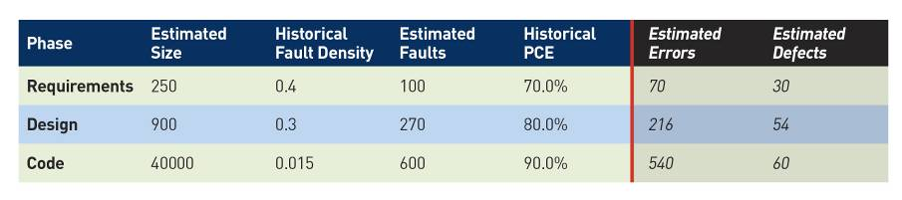
Predicting Errors And Defects
Step 1: Collect historical project data to calculate these metrics for your organization.
Step 2: Statistically predict faults, errors and defects for each phase, based on the estimated size of the current release
Notes:
Historical project data should be collected to calculate these metrics for organizations.
With FD, PCE and PSE values, the QA manager can statistically predict faults, errors and defects for each phase, based on the estimated size of the current release

Slide 15
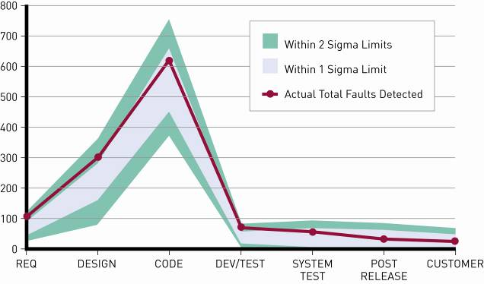
Tracking Project Performance
Step 3: Use objective fault graphs to analyze the performance of your quality process and benchmark performance against other companies.
Notes:
With objective fault graphs, QA managers can analyze the performance of their quality process within the company as well as benchmark this performance against other companies.

Slide 16
Delivering Value Up Front
By implementing Strategic QA, QA managers can deliver incredible value to the organization.
Reduce project delays and meet time-to-market promises by producing reliable budgets, schedules and testing plans,.
Increase productivity by allocating testing resources in the most efficient way, for the highest impact.
Notes:
By implementing Strategic QA, organizations can be deliver incredible value to the organization:
Produce reliable schedules and testing plans
Allocate testing resources in the most efficient way, for the highest impact.
Better budget and schedule estimates lead to predictable, reliable time-to-market

Slide 17



Renesas
Strategic QA with Synergy
Business Challenge
Customer Success
Improve processes across the development cycle
Raise quality
Slash time-to-market
Implemented the best of CMMI, Agile, and Six Sigma approaches
Quarterly releases with clear functionality
Metrics predict bug numbers
Focused process effort for ROI
“Straight away, we focused on Telelogic Synergy because we knew that task-based configuration management would help us keep our project on track and improve product quality.”
Cut time-to-market by 30%
Bug correction time down 75%
Notes:
Customer: Renesas Design France, a subsidiary of Renesas Technology Corporation, a joint venture between Hitachi and Mitsubishi Semiconductors, is one of the world's leading semiconductor system solutions providers
Situation: The company needs to implement CMMI practices to improve its processes and become more competitive
Solution: Renesas Design France chooses Telelogic Synergy™ Suite, including Telelogic Change™ and Telelogic Synergy, to improve change control, communication, configuration management, and release management
Bottom Line: Telelogic Synergy Suite helps Renesas Design France improve processes across the development cycle, raise quality, and slash time-to-market
The Story
In 2005, Renesas Design France initiated a CMMI process improvement initiative. They decided to migrate to a change and configuration management solution that would manage both their hardware and software assets, support their existing processes, and improve product quality.
“Straight away, we focused on Telelogic Synergy Suite because we knew that task-based configuration management would help us keep our project on track and improve product quality,” says Stéphane Thomas, Quality Manager, Renesas Design France.
Better Diagnosis and Communication with Telelogic Change
After selecting Telelogic Synergy Suite, Renesas Design France quickly discovered that Telelogic Change not only manages all change requests and bug reports, it also tracks current status and provides process improvement reports.
For each bug report, Renesas Design France now captures the development phase in which the error was found and, upon resolution, also indicates the phase in which the error could have been avoided. This causal analysis, which aligns to CMMI best practices, enables the company to identify the process areas where improvement will deliver the highest return on investment.
“This level of insight would be impossible to implement in most other tools,” Stéphane Thomas said. “With Six Sigma metrics on Defect Containment Effectiveness and Defect Screening Effectiveness, Renesas Design France is able to continually improve its organizational development process.”
The dynamic metrics provided by Telelogic Change highlight dangerous trends on defects. Because Telelogic Change identifies errors early in the lifecycle, they can be fixed more cheaply than is possible in later phases. In addition, to improve its distributed development processes, Renesas Design France uses Telelogic Change to communicate with other design centers, which submit change requests into the system via the Web.
Better Control and Resolution with Telelogic Synergy
Thomas, who was familiar with other configuration management products, was impressed to discover that Telelogic Synergy combines Configuration Management with project planning.
“Renesas Design France produces ‘Agile’ program releases approximately every quarter to ensure smooth integration and partner coordination,” Thomas said. “Each release is a milestone with clear functionality. Telelogic Synergy is able to easily accommodate the company’s methodology.”
Telelogic Synergy also accelerates bug correction. Once a defect is identified, a corrective task can be created, implemented, then quickly and easily applied to a release. The reactivity metrics measured by Renesas Design France indicate that Telelogic Change and Telelogic Synergy significantly reduce defect correction lead-time.
Enhancing Existing Processes
Renesas Design France sees change and configuration management, and its impact across the development cycle, as the first step in its CMMI process improvement initiative. The reports and metrics that Telelogic Change and Telelogic Synergy provide will help the company quickly identify other process areas where improvement is needed. Causal analysis also enables Renesas Design France to focus its efforts efficiently. Metric history allows development staff to predict the number of bugs a program will have, based on the number of requirements, before design even takes place.
“Synergy provided us with really important control over our development; the program management it enabled allowed us to cut time-to-market by 30 percent compared to our previous high-end CM solution,” says Thomas. “With Telelogic, we really have found the ideal solutions to help us improve quality.”
The Benefits
After the initial purchase in 2005 and deployment to 50 users, Renesas Design France has already measured many high-level benefits:
Supports the best of CMMI, Agile, and Six Sigma approaches
Complete control of releases and deliveries
Enhanced communication
Faster reaction time
Improved process across all the development cycle
The return on investment of Telelogic Synergy Suite is clear for Renesas Design France. Based on the success of Synergy Suite, Renesas Design France is planning to extend the rollout to 150 users.

Slide 18



The Benefits Of Process Improvement
CMMI-assessed organizations measured and reported clear improvements
  Productivity
  Quality
  Schedule
  Cost
  Customer Satisfaction
Mean Return on Investment measured = 4.8 : 1
  Varies from 2:1 to 27.7:1!
© 2006 by Carnegie Mellon University
Notes:
Leading organizations have successfully attained return on investment (ROI) for process improvement initiatives by adopting the Software Engineering Institute’s Capability Maturity Model® Integration (CMMI®). Of the 878 organizations assessed by the SEI in 2005, two-thirds reported a clear increase in productivity, and half of them reported an increase in quality. When asked to measure ROI, the mean value reported was nearly 5 to 1, with some organizations reporting an ROI of up to 27–to-1.

Slide 19


Process Improvement – Where To Start?
Where should I focus my process improvement budget?
How can I justify my decisions and prove that they made a difference?
If only I could identify in which phase our bugs were actually introduced, we could see what needs to be fixed…
… and track the trends to see if we made a difference…

Slide 20
Causal Analysis and Resolution
Meeting CMMI levels 3 and above:
  Implement a standard set of processes across the organization,
  Continually improve based on objective, measured feedback.
The Causal Analysis and Resolution key practice:
  Identify causes of defects and errors
  Take action to prevent them from occurring in the future.
Improve quality and productivity by proactively preventing the introduction of defects into a product.
Notes:
One of the fundamental principles of the CMMI is the implementation of a standard set of processes across the organization, which are continually improved based on objective, measured feedback. In particular, the CMMI recommends the key practice of Causal Analysis and Resolution. When implementing this practice, organizations identify causes of defects and errors and take action to prevent them from occurring in the future. Causal Analysis and Resolution improves quality and productivity by proactively preventing the introduction of defects into a product.
Strategic QA is an example implementation of Causal Analysis and Resolution and should be considered by all organizations aiming for CMMI level 3 certification (and above).

Slide 21
Capturing The Error And Defect Data
The data necessary for QA metrics must be captured when faults are identified and analyzed:
  Fault description
  Fault category
  The phase in which the fault was detected
  How the fault was found
  The phase in which the fault was introduced
  The phase in which the fault should have been detected
  The cost of the fault
  Extra information provided by the submitter or later in the process…
Notes:
The data necessary for the QA metrics mentioned previously must be captured when faults are identified. This process is facilitated by the roll-out of an Enterprise Change Management (ECM) solution for consistent fault tracking. Web-based ECM solutions provide customizable forms to collect the relevant data for each fault. By providing a user-friendly interface with drop-down list boxes, organizations can ensure that quality feedback is easy for users to provide.
Enterprise Change Management solutions produce the forms, processes, metrics, reports and graphs necessary to capture, summarize and analyze the data for Strategic QA. They enable organizations to view which links of their process are the weakest and where to focus process improvement budgets.

Slide 22
The Need For Enterprise Change Management
Garbage in, Garbage out!
To successfully improve the way they produce software, organizations need to capture error and defect data in a consistent, centralized fashion.
This process is facilitated by the roll-out of Enterprise Change Management (ECM)
  User-friendly Web-based interface
  Customizable forms to collect the relevant data
  Drop-down list boxes
  Repeatable, documented and reliable process
Enterprise Change Management provides the forms, processes, metrics, reports and graphs necessary to capture, summarize and analyze the data for Strategic QA.
Notes:
To successfully improve the way they produce software, organizations need to capture error and defect data in a consistent, centralized fashion. Enterprise Change Management, the cornerstone for sustainable compliance as well as causal analysis and resolution, enables organizations to implement a repeatable, documented and reliable process for capturing both fault data and change requests of all types, on software and hardware, from customers and the internal teams, urgent and minor. By offering a Web interface, ECM solutions ensure ease of adoption across the enterprise.
Naturally, an organization wishing to deploy and enforce an Enterprise Change Management solution must verify that it is scalable to its needs and flexible enough to implement a process that reflects the corporate culture and solves the identified challenges.
The solution must also be capable of providing a common, consistent process across the organization. Products that provide out-of-the-box, industry-proven processes are a natural choice for low-risk deployment.

Slide 23
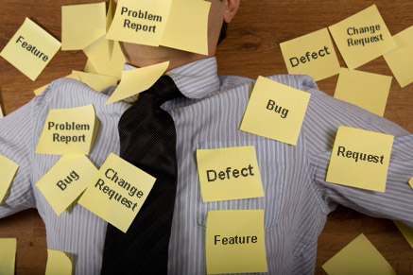
Managing The Change Workflow Across The Organization
Change is Omnipresent
  Bugs, enhancements…
  The promise of SOA
Change is Critical
  Inherent Risk
Process and quality initiatives
Governance and accountability
Scalability, deployment and cost
You can leverage this challenge for a Competitive Edge!

Slide 24
Enterprise Change Management helps organizations meet key CIO challenges
Reduce the cost of running operations while providing world class support
Meet compliance & governance requirements
Improve productivity while reducing cost of development and time to market
Capture, manage and leverage knowledge
Measure and improve development process – improve value of every $ spent
Notes:
Reduce the cost of running operations while providing world class support
Replace existing, costly systems
One common system, with a unique repository
Extremely scalable, Web-based access
Low cost of ownership and of deployment (maintain, document, automate, integrate)
Web services and APIs for easier, cost-effective integration
Lower overall cost
Enabling a paperless process & reducing travel costs with global access, reporting and virtual meetings.
Low risk, simple move
Migration tools
Ready-to-use process packages
Meet compliance & governance requirements
Guaranteeing data integrity and consistency
Reliable data
No conflicting data
Controlled access rights, e-signature
Enforcing a controlled, repeatable process
Bring together global teams
Increase process consistency and formalize usage
Meet regulations and standards
Providing audit information and reporting
Reporting, metrics – each level has the right info
Quality initiatives visibility, audits + evidence
Faster response to audits
Overall visibility into process, trends and progress.
Improve productivity while reducing cost of development and time to market
Better Quality
Less errors in captured content,
Better implementation of change & requirements
Improve quality of deliverables
Avoid rework (costs time and money)
Lower the cost and risk of responding to change
Response and notification, Triage, priorities
Change is addressed at a lower cost & faster
Impact analysis
Communication and coordination
Get the right supporting data to the right people in a timely manner
Collaborate about product change,
End to end visibility into the change lifecycle
Capture, manage and leverage knowledge
Leverage this information for your projects
Searchable database for analysis
Turnover
Capture info – in house, partners, outsourced
Leverage: analysis, predictions, hindsight, real-time
Are you losing control? We need info!
Leverage for other projects
Predict correct cost & schedule
Post-mortem – comments, discussions
Comments, decisions, history
Re-use
Don’t repeat mistakes, re-use good material
Measure and improve development process – improve value of every $ spent
Improve your process
Standardize
Strategic QA and Causal analysis
Identify weak process points
Where to focus the process improvement budget
Justify decisions and prove that they made a difference
Display the benefits
Reports, metrics

Slide 25
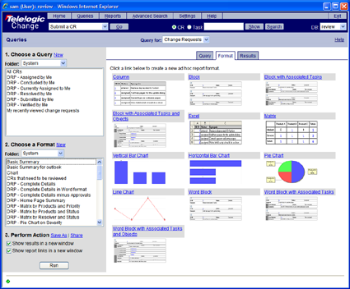

Telelogic Change: Consistently Managing Change Across Your Organization
Robust repository for managing and communicating process & change
Workflow and task assignment management
Easy deployment and customization
Built-in lifecycle editor
Real time reporting and metrics
Distributed team support
Telelogic Synergy & Change: Awarded “Best Change & Configuration Management solution EIGHT consecutive years
Notes:
This is the first introductory slide to Telelogic Change. We can spend a minute or two explaining what it is. Then we will go into who uses it and why for clarity.
Status
New issues
Metrics
Release notes
Assignments
Keyword search
Traceability

Slide 26
Introducing the Telelogic Enterprise Change Process
What makes Telelogic Change different from all other products?
The Enterprise Change Process:
An out-of-the-box solution
providing a low-risk, high-ROI process package
for user-friendly, consistent change management
across organizations of all types and sizes

Slide 27

Eliminate The Risk Factor
With Industry-proven Solutions
Business Challenge
Customer Success
Time to market & margins
A truly global company
“90% of integration is change control”
900+ active users world-wide
Passed CMM audits
Significantly less resource use
Adopted by other divisions and companies
"The process and toolset now available as the ECP are generic, robust and comprehensive, yet remain intuitive for the end-user and scalable to meet Change & Problem management demands of our development projects"
Up to 50% decrease in throughput times

Slide 28
A Winning Strategy For All Organizations
"Telelogic has a very compelling offer with the Enterprise Change Process.
Over the next few years we will continue to see strong growth in the adoption of Enterprise Change Management solutions like Telelogic Change --particularly by organizations seeking to respond efficiently to change and reduce development costs by ensuring application quality through best practices, such as CMMI.
Telelogic has a winning strategy, by providing ready-to-use solutions that have proven success and scalability to coordinate change and workflow across the organization."
Teresa Jones, Senior Research Analyst, Butler Group

Slide 29

Change Management: The Road To Innovation
Enterprise Change Management is much more that controlling bug reports
Improve Predictability
Improve Quality
Meet Compliance Objectives
Control cost of development

Slide 30
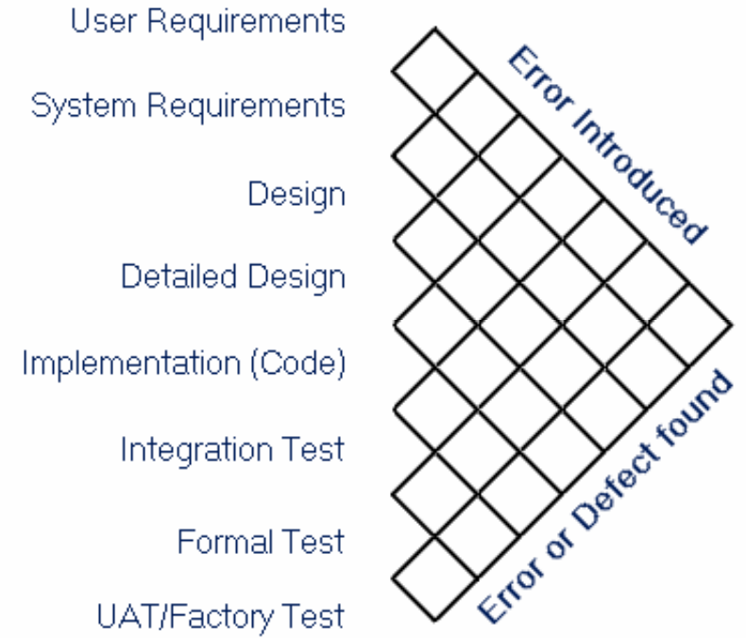
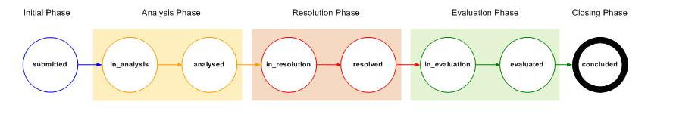
Unique Innovative Functionality
Telelogic provides key functionality
  CMMI and SPICE compliance
  Strategic QA
  Project scheduling
  Effort estimation
  Causal analysis
  Process enforcement
  Duplicate management
1
1
2

Slide 31
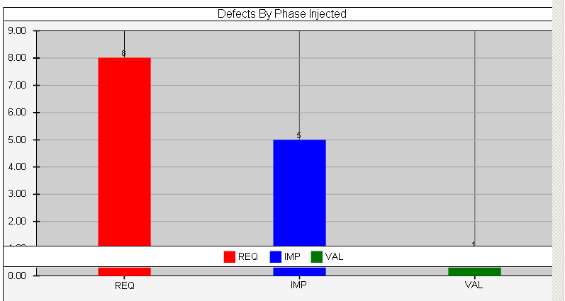
Full Metrics Dashboard
Focusing your process improvement effort
Dashboards & Graphing
Data Collection
Telelogic Dashboard automatically analyzes your development process to help you focus your investments – and prove you made a difference
Notes:
SEI CMMI,
IEEE 983 Quality Assurance Plans,
IEEE 1061 Software Quality Metrics Methodology

Slide 32

Rolling Out Across The Organization
The solution needs to meet today’s needs, and tomorrow’s…
Project types
Locations
Roles
Languages
Stakeholders
Processes

Slide 33
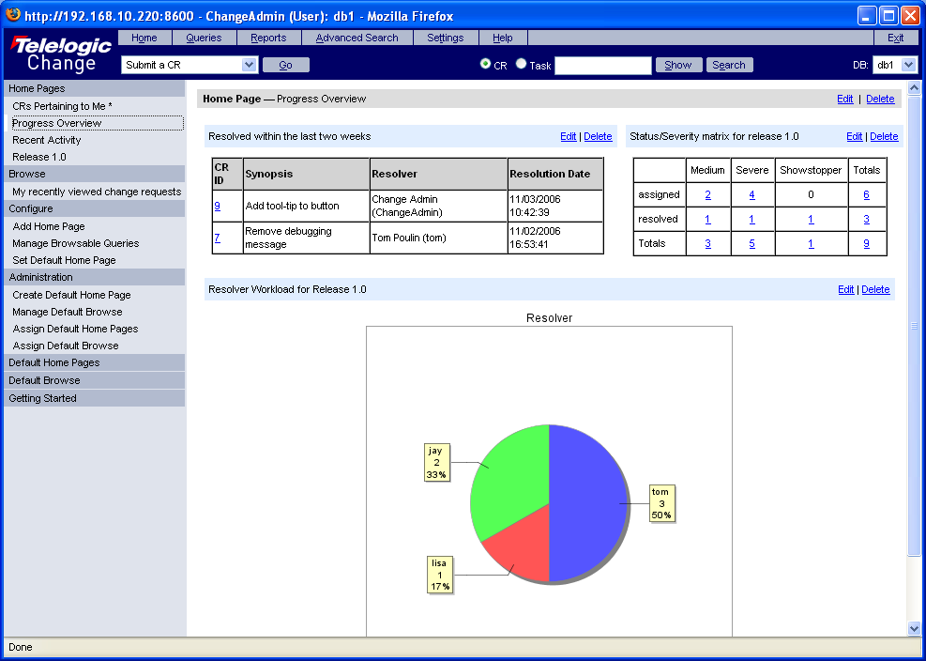
Proven Scalability
Secure Web access to the central repository
Hierarchy of change requests to drill down into specialities
Roles, responsibilities and automatic notification to avoid bottlenecks and delays
Queries and fast analysis to improve triage of priorities
Corporate roll out to reap benefits

Slide 34
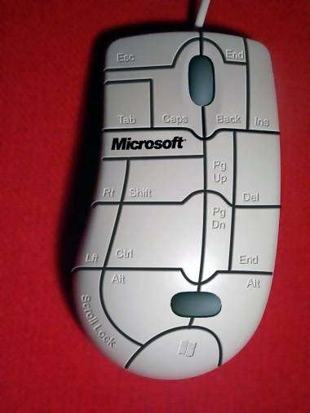
The Importance of Usability
Implementing advanced functionality and meeting all types of needs…
The solution must be user-friendly
  Field acceptance
  Global roll-out
  Cost of training

Slide 35

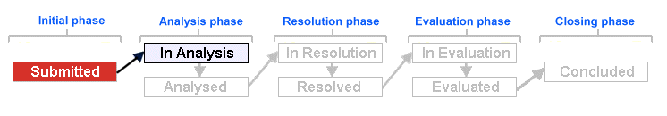
Proven Usability
The ECP has been tuned on real projects for usability:
  Interactive auto-generated help
  “You are here” process map
  Main transition prompt
  Collapsible color-coded sections
  A common multi-purpose process
  Role-based home pages
“[Telelogic’s Change and Configuration Management solution] achieves highest rating in our easy of use category , while providing very advanced functionality. This makes it an ideal choice for enterprise-wide deployment.“

Slide 36

Cheaper Than Free?
What is the Total Cost of Ownership and the Return on Investment?
How does this solution make me more competitive?
Requirements:
  Straightforward to use
  Fast to set up and deploy
  Cost effective to maintain
  Low cost of training
  Provide integrations to lifecycle solutions

Slide 37
A Low-risk, High ROI Solution
Already successfully deployed across large distributed organizations
Successfully passed audits
Minimal cost of training and deployment
Open Web Service integration platform
Predefined reports and metrics
More cost-effective than:
  High-end complex solutions
  Stretching the usage of existing products
  Developing a home-grown solution
Easier organizational and executive buy-in

Slide 38
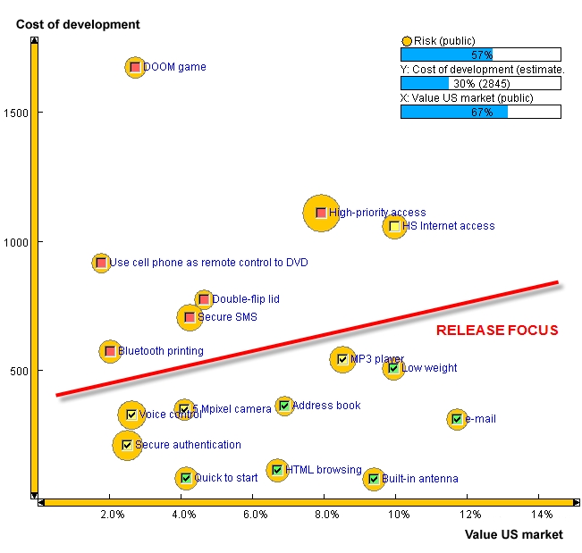
Bringing Together Stakeholders And Experts
Telelogic Change enables a complete ALM solution
  With integrations to leading lifecycle products
Impact analysis and requirements to code traceability
Regression testing and bug solving
Full traceability to software configuration management and task assignment
A unique solution to meet today’s challenges of scalability, complexity, cost-control and accountability

Slide 39
The Telelogic Change and the Enterprise Change Process
An out-of-the-box solution
providing a low-risk, high-ROI process package
for user-friendly, consistent change management
across organizations of all types and sizes
Telelogic Synergy & Change: Awarded “Best Change & Configuration Management solution each time since 2000

Slide 40
Introducing Strategic QA
Strategic QA helps organizations
Track faults across the software development lifecycle,
  Providing teams with the insight necessary
  to predict fault levels,
  to focus process improvement and testing budgets
  and demonstrate results and ROI.
Strategic QA not only helps organizations become more competitive, it also reaffirms the value of the QA manager in the project team and the organization.
Notes:
… helps organizations track faults across the software development lifecycle, providing QA managers with the insight necessary to predict fault levels, testing budgets and, more importantly, allows them to focus process improvement budgets in an efficient way, with provable benefits. Strategic QA not only helps organizations become more competitive, it also reaffirms the value of the QA manager in the project team and the organization.

Slide 41
Thank you for listening!!
Dominic.Tavassoli@telelogic.com

Slide 42
Q & A
Have a question for the speakers?
Ask now.

